Slide 1


Justin Stewart
10/24/2022

Slide 2
Outline
Executive Summary
Introduction
Methodology
Results
Conclusion

Slide 3
Executive Summary
Summary of methodologies
Data Collection
Data Collection via Web scraping
Data Wrangling
EDA w/ data visualization
EDA w/ SQL
Building an interactive map w/ Folium
Building a Dashboard w/ Plotly Dash
Predictive analysis w/ Classification Models
Summary of all results
EDA results
Interactive analytics
Predictive analysis via classification models

Slide 4
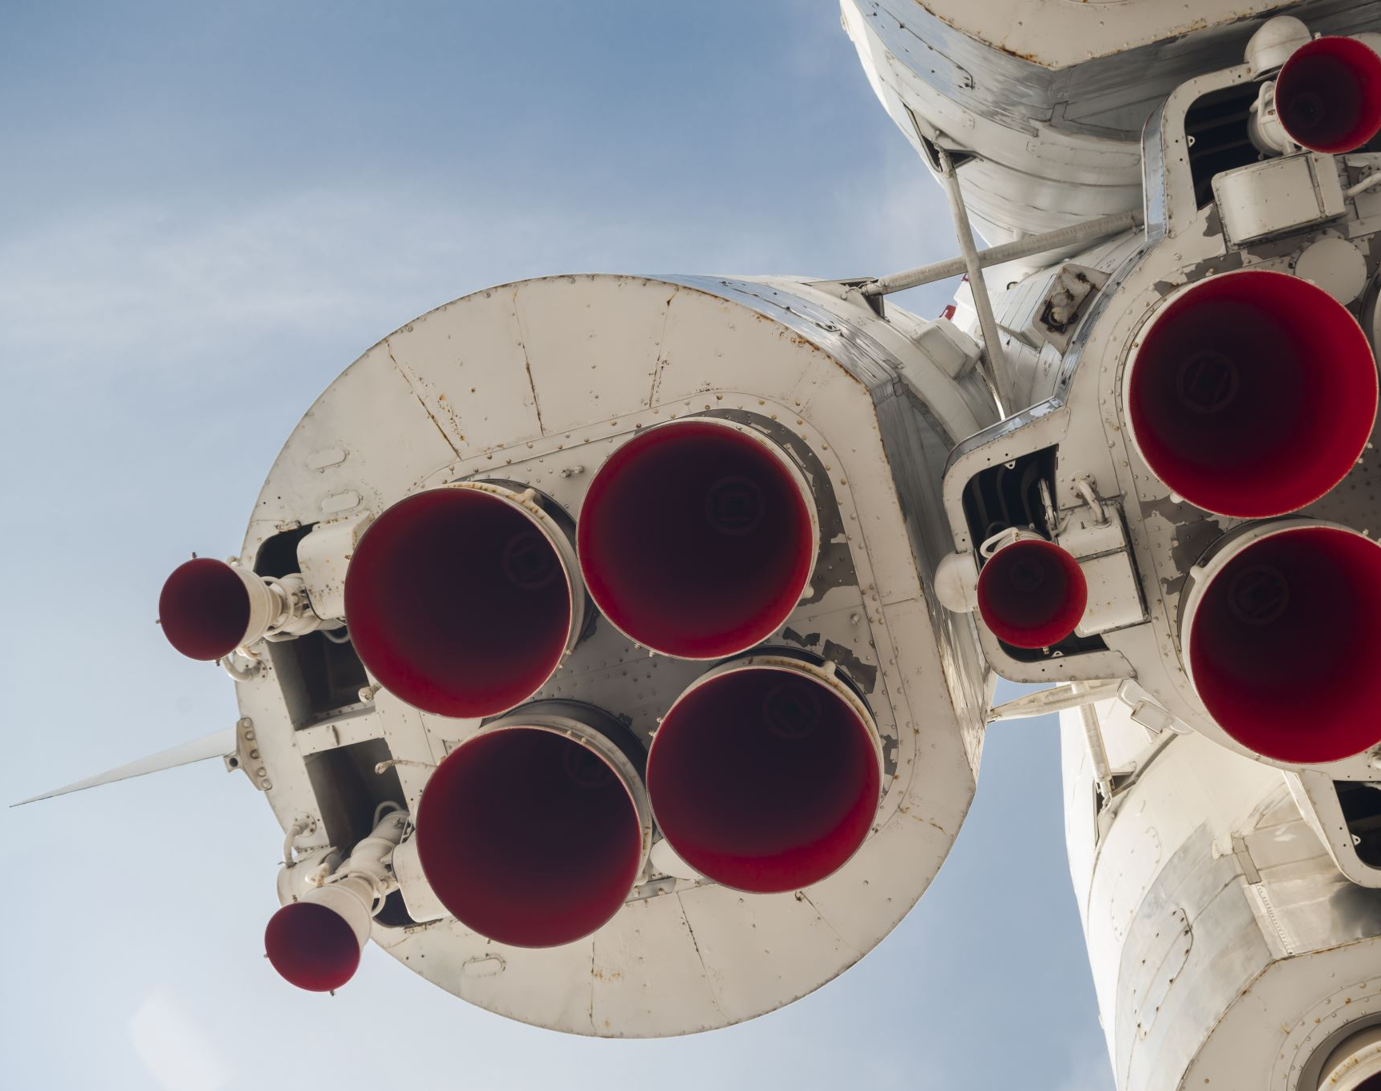
Introduction
The modern commercial space age is currently geared toward making space travel affordable for everyone. One of, if not the most successful company accomplishing this task is SpaceX. SpaceX advertises launches of their Falcon 9 rocket at a cost of 62 million dollars. Typically, this sort of launch may cost upwards of 165 million dollars, but due to SpaceX’s ability to recover and reuse the first stage of their rockets, they are able to minimize costs. Through successful replication of this process, the price of space travel is allowed to decline even further. As a Data Scientist of a startup rivaling SpaceX, the goal of this project is to predict future landing outcomes in order to accurately predict the cost of rocket launches and compete with SpaceX.
Problems To Explore:
What factors contribute the most to a successful rocket landing?
What is the relationship between each variable, and how is it affecting the landing outcome?
What combination of variables produces the highest success rate?

Slide 5

Section 1

Slide 6
Executive Summary:
Data Collection Methodology
SpaceX API
Web scraping tables
Perform Data Wrangling
Determine labels to train the classification model
One Hot Encoding categorical variables
Data cleaning of null values and non-essential columns
Perform Exploratory Data Analysis (EDA) Using Visualization & SQL
Exploratory analysis performed utilizing various forms of visualization (Bar, Scatter, Line) to aid in the feature selection/engineering process
Perform Interactive Visual Analytics Using Folium & Plotly Dash
Create interactive map to determine the correlation between launch sites and successful landing outcomes
Perform Predictive Analysis Using Classification Models
LR, KNN, SVM, DT models built and evaluated to determine the best classification model
Methodology

Slide 7
Data Collection
Methods of Data Collection:
SpaceX API requests (Requests, Pandas & SQL)
Converted response content to .json using .json()
Converted .json to pandas dataframe with .json_normalize()
Web scraping data from SpaceX’s Wikipedia (Requests, Pandas & BeautifulSoup4)
Launch records HTML table located on the SpaceX Wikipedia scraped via Pandas, BeautifulSoup4 and converted into pandas dataframe for analysis

Slide 8
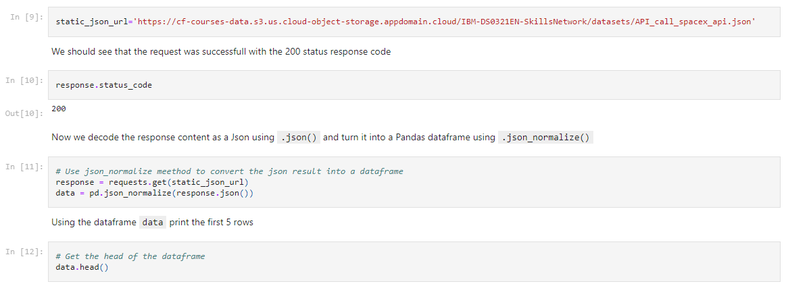
Data Collection – SpaceX API
Utilized the requests library to collect data from the SpaceX API
Data Wrangling / Preparation performed on the requested data.
Link to Notebook: https://github.com/NotBlasto/Applied-Data-Science-Capstone-Project/blob/main/Data%20Collection.ipynb

Slide 9
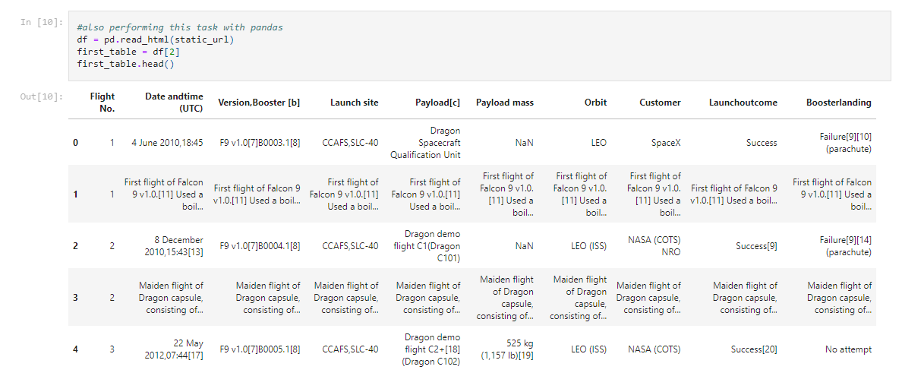
Data Collection - Scraping
Present your web scraping process using key phrases and flowcharts
Link to Github: https://github.com/NotBlasto/Applied-Data-Science-Capstone-Project/blob/main/Data%20Collection%20W_%20Web%20Scraping.ipynb

Slide 10
Data Wrangling
Exploratory data analysis performed
Determine labels to train the classification model
One Hot Encoding categorical variables
Data cleaning of null values and non-essential columns
Link to Notebook:
https://github.com/NotBlasto/Applied-Data-Science-Capstone-Project/blob/main/Data%20Wrangling.ipynb

Slide 11
EDA with Data Visualization
Various forms of data visualization were utilized during the exploratory data analysis process:
Scatter Plots were used to identify the correlation between various independent and dependent variables such as the success of a flight based on its payload mass and orbit
Bar charts were used to identify the success rate of launches based on each type of orbit
Link To Notebook: https://github.com/NotBlasto/Applied-Data-Science-Capstone-Project/blob/main/EDA%20W_%20DATA%20VIZ.ipynb

Slide 12

EDA with SQL
Connected and read .csv file to Sqlite database utilizing SQL magic commands
Performed exploratory data analysis with SQL utilizing queries to find:
The names of unique launch sites
Total payload mass carried by boosters launched by NASA (CRS)
Average payload mass carried by F9 v1.1 boosters
Total amount of successful and unsuccessful launches
Identified the booster version and launch site name of failed landing outcomes on drone ships.
Link To Notebook: https://github.com/NotBlasto/Applied-Data-Science-Capstone-Project/blob/main/Spacex%20SQL%20Magic%20EDA.ipynb

Slide 13

Build an Interactive Map with Folium
Utilizing Folium to build an interactive map we:
Created a map and marked all launch sites
Added map objects such as markers, circles, and lines to provide additional information such as site distance from geographic landmarks
Utilized color-labeled marker clusters to identify launch sites with high success rates
Link To Notebook: https://github.com/NotBlasto/Applied-Data-Science-Capstone-Project/blob/main/Spacex%20Launch%20Site%20Locations%20Map%20W_%20Folium.ipynb

Slide 14

Build a Dashboard with Plotly Dash
Constructed an interactive dashboard with Plotly Dash that allows the user to view the data from their desired perspective
Plotted pie charts showing the total successful launches by all sites, as well as the ability to filter to specific sites only.
Plotted scatter plot to present the user with detailed information about the relationship between landing outcomes and payload mass for different booster versions.
Link To Notebook: https://github.com/NotBlasto/Applied-Data-Science-Capstone-Project/blob/main/spacex_dash_app_final.py

Slide 15
Predictive Analysis (Classification)
In order to accurately predict launch outcomes we:
Loaded data utilizing numpy and pandas into dataframes
Split our data into training and testing sets (80/20 split)
Built four separate classification machine learning models tuned with various hyperparameters through grid search cross-validation
Evaluated each model by its accuracy, best accuracy, and area under the curve to determine the best model.
Link To Notebook: https://github.com/NotBlasto/Applied-Data-Science-Capstone-Project/blob/main/SpaceX_Machine%20Learning%20Prediction.ipynb

Slide 16
Results
Exploratory data analysis results
Interactive analytics demo in screenshots
Predictive analysis results

Slide 17

Section 2

Slide 18
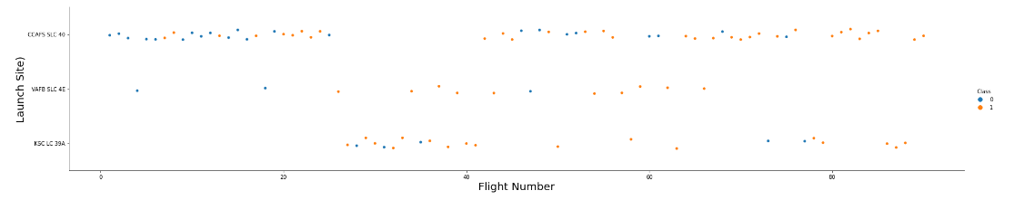
Flight Number vs. Launch Site
From the above scatter plot, we can see that the amount of flights, or Flight Number, is positively correlated with a successful launch at each launch site. I.E. the more flights at a launch site, the greater the success rate at that launch site.

Slide 19
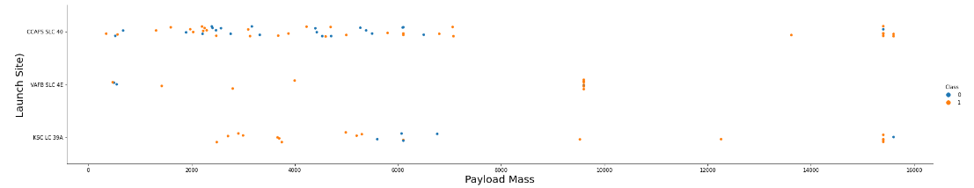
Payload vs. Launch Site
From the scatter plot above, we gain a few insights:
The greater the payload mass the less likely it is that the first stage will return successfully.
Launch site VAFB-SLC has no launches with a payload mass greater than 10000 kg.

Slide 20
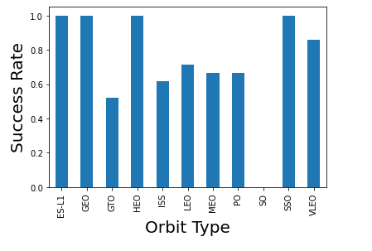
Success Rate vs. Orbit Type
From the provided bar plot, we can see that launches dedicated to the orbits ES-L1, GEO, HEO, and SSO have the highest success rate.

Slide 21
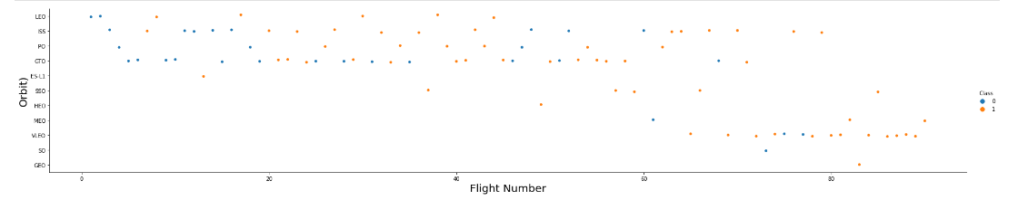
Flight Number vs. Orbit Type
By creating a scatterplot between the number of flights (Flight Number) and Orbit type two interesting relationship insights emerge:
In the LEO orbit, successful landing outcomes appear to be strongly correlated to the number of flights.
In the GTO orbit, the number of flights seem to have no correlation to success landing outcomes.

Slide 22
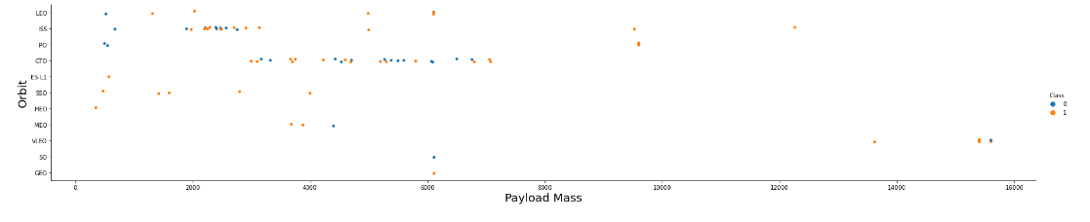
Payload vs. Orbit Type
From the above scatter plot we can observe that heavy payloads have a much higher rate of success in the PO, LEO, and ISS orbits.
For the GTO orbit the data is less conclusive, as there are many failures and successes in the same payload ranges.

Slide 23
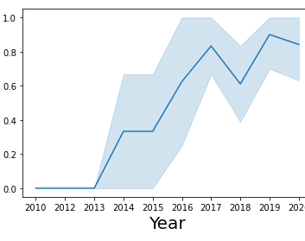
Launch Success Yearly Trend
The line plot provided shows us that there is a strong positive correlation between years and success rate, meaning as time increases, so does our rate of success.
We also see that success rate did not begin increasing until 2013.

Slide 24
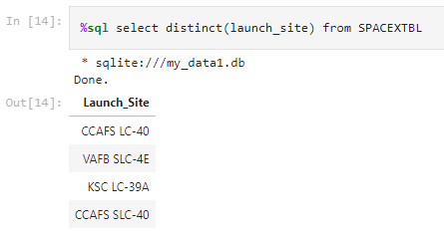
All Launch Site Names
Utilizing SQL’s DISTINCT keyword, we are able to show each unique launch site available in the SpaceX dataset.

Slide 25
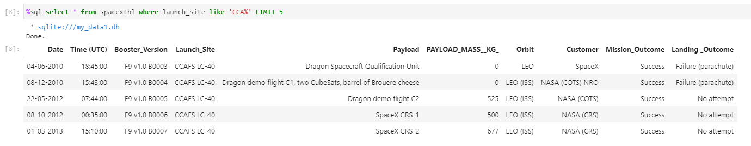
Launch Site Names Begin with 'CCA'
We used the following query to display 5 records in which launch sites began with ‘CCA’

Slide 26
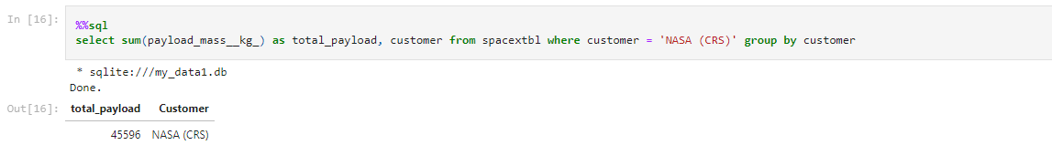
Total Payload Mass
The query above shows us that the total payload mass carried by boosters from NASA (CRS) is 45,596 kg through the usage of the SUM() SQL function.

Slide 27
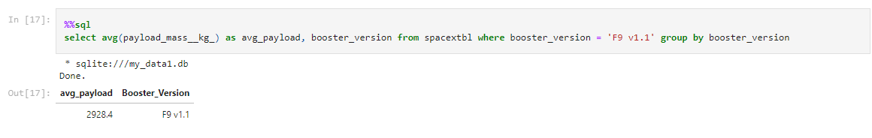
Average Payload Mass by F9 v1.1
The query below utilizes the AVG() SQL function to display the average payload weight carried by F9 v1.1 boosters in kilograms.
The average payload carried by F9 v1.1 boosters is 2928.4 kg.

Slide 28
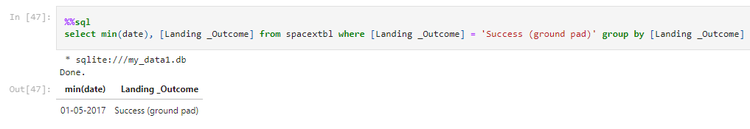
First Successful Ground Landing Date
Utilizing the MIN() function we observe that the first successful ground landing was on May 1st, 2017.

Slide 29
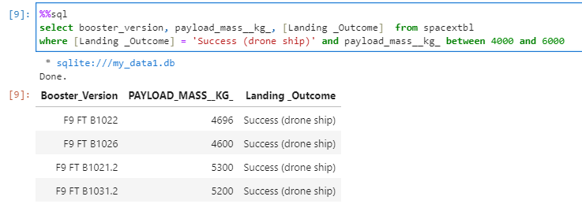
Successful Drone Ship Landing with Payload between 4000 and 6000
The WHERE, AND, and BETWEEN clauses were utilized to filter the data for successful drone ship landings with a payload mass between 4000 and 6000 kg.

Slide 30
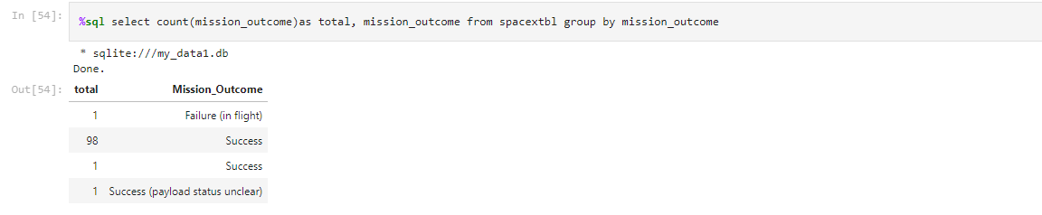
Total Number of Successful and Failure Mission Outcomes
Through the usage of the COUNT() SQL function, we observe that there have been a total of 100 successful mission outcomes, and 1 failure that occurred in flight.
We are, however, unsure of the payload status in one of these successes.

Slide 31
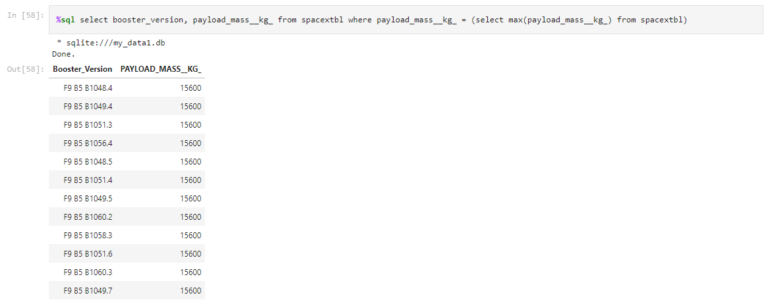
Boosters Carried Maximum Payload
By utilizing a subquery to select the maximum payload value for each booster version, we observe that all boosters carrying the maximum payload are F9 B5 boosters.

Slide 32
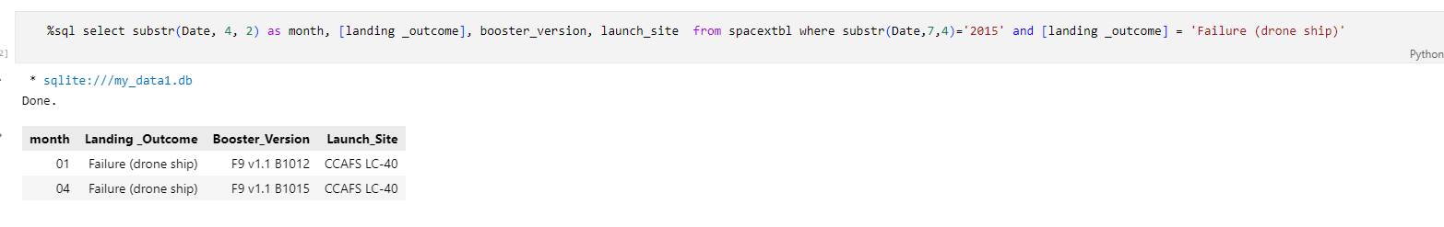
2015 Launch Records
By using the substr() SQL function in the query below, we are able to retrieve the months in which drone ship landing failures occurred in 2015.
From this query we observe that both of these failures occurred at the same launch site.

Slide 33
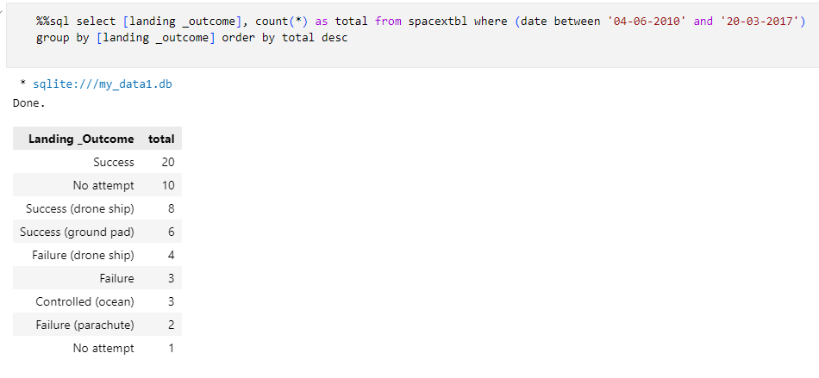
Rank Landing Outcomes Between 2010-06-04 and 2017-03-20
Through the combined usage of SQL’s COUNT and BETWEEN keywords, the query produces a result that ranks landing outcomes between June 4th, 2010, and March 20th, 2017.

Slide 34

Section 3

Slide 35
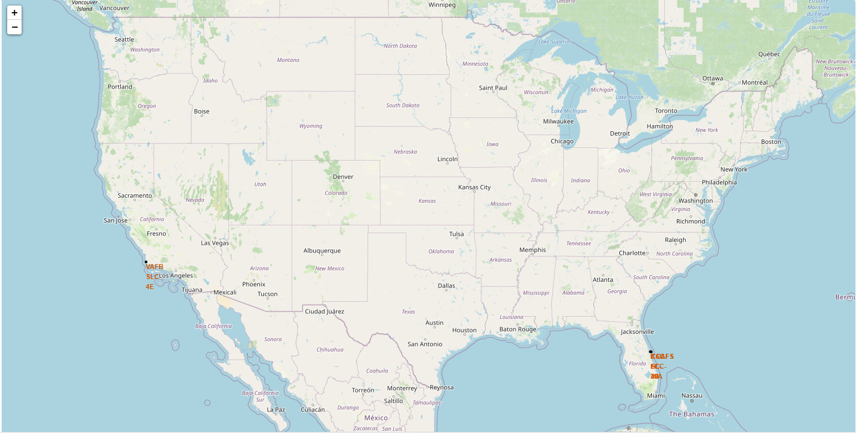
All Launch Sites With Interactive Global Map Markers
In the above screenshot we see that each launch site (many are overlapping due to proximity) are located on the southern coastal regions of the United States.

Slide 36
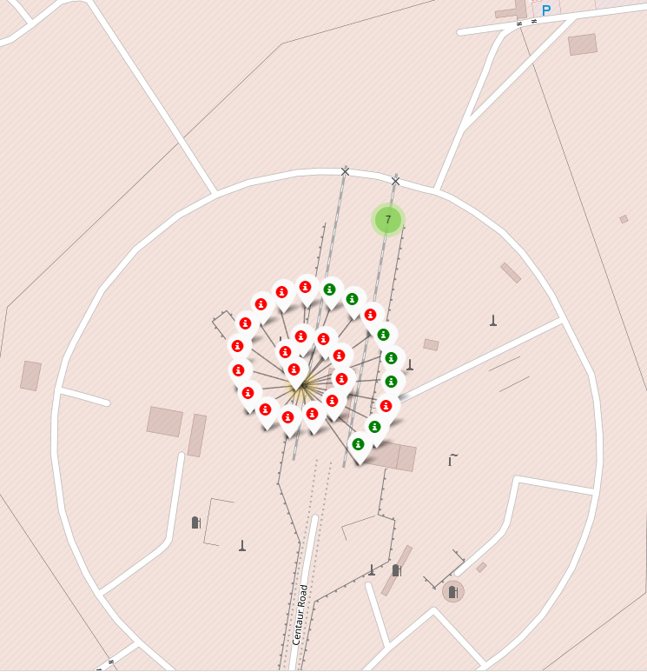
Launch Sites In Close Proximity
By utilizing marker clusters, we are able to identify the exact location of launch sites that otherwise would be too close in proximity to identify.
Through the combined usage of labels and colors we are able to identify which launches were successful as well as the site in which launches occurred.

Slide 37
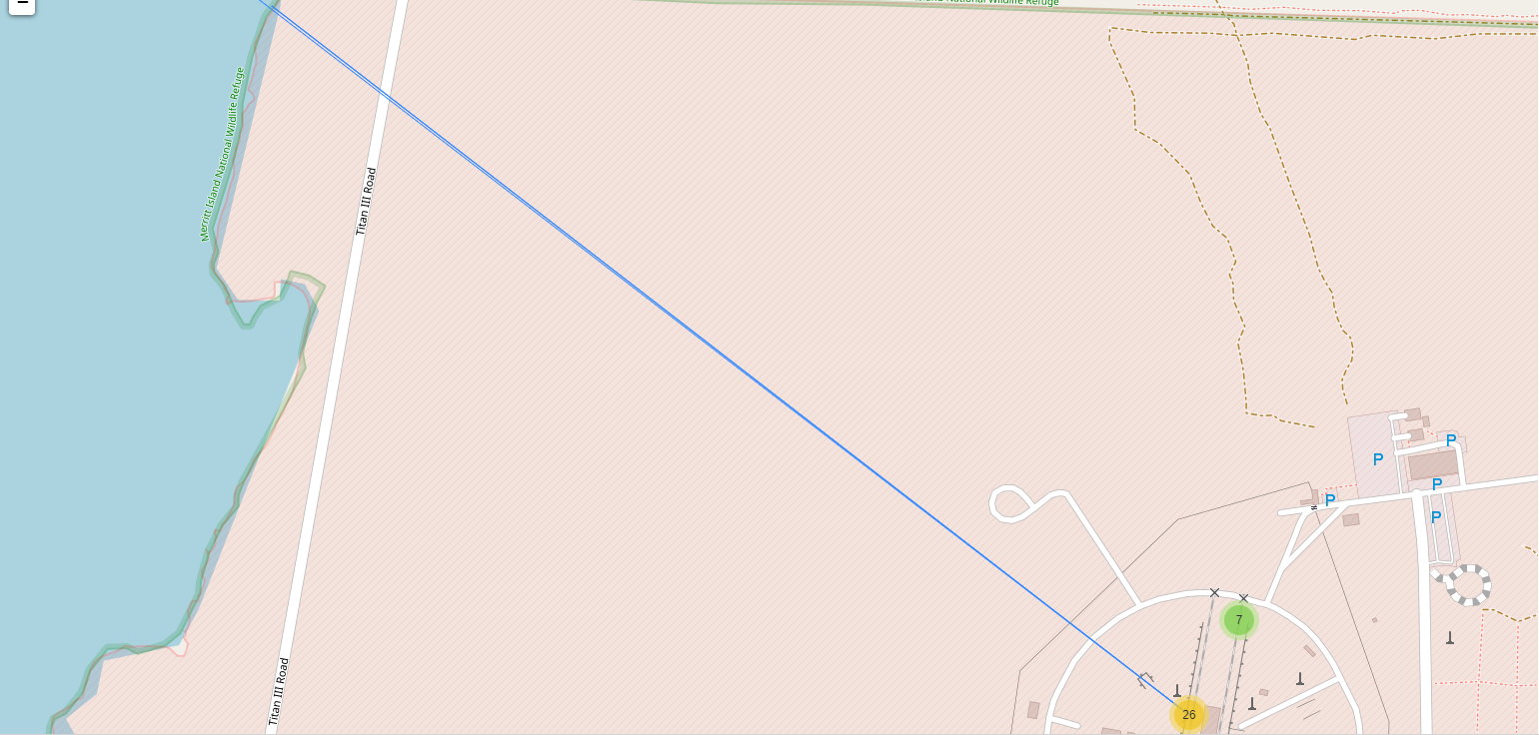
Geographic Significance of Launch Sites
By adding lines to our map, we can see the distance of launch sites to geographic features such as water, railroads, and highways. It appears launch sites have a strong preference to keep away from cities, and near water sources.

Slide 38

Section 4

Slide 39
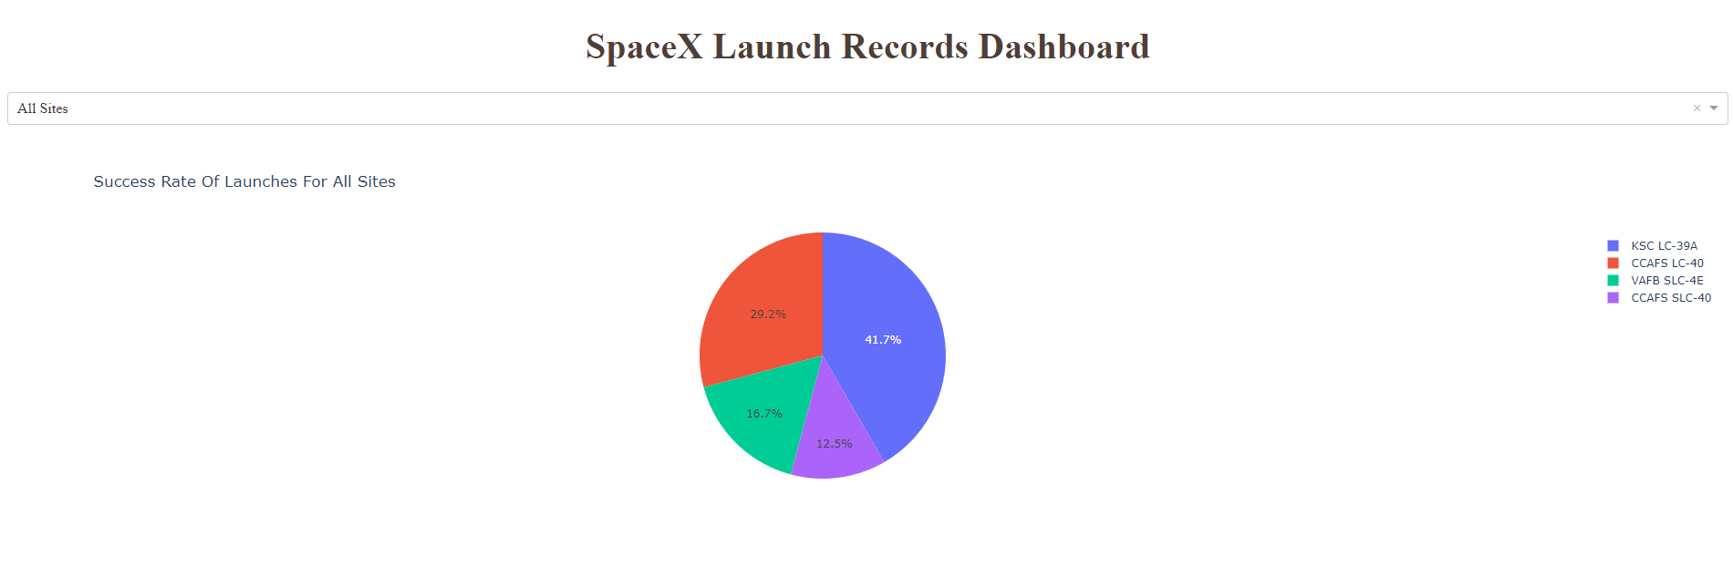
Pie Chart: Success Rate Of All Launch Sites
We observe that the KSC LC-39A launch site had the most successful launch rate, making up 41.7% of all successful launches.
We also observe that the overall success rate of launches is below 50%, meaning not even half of the total launches across all sites successfully land to be recovered.

Slide 40
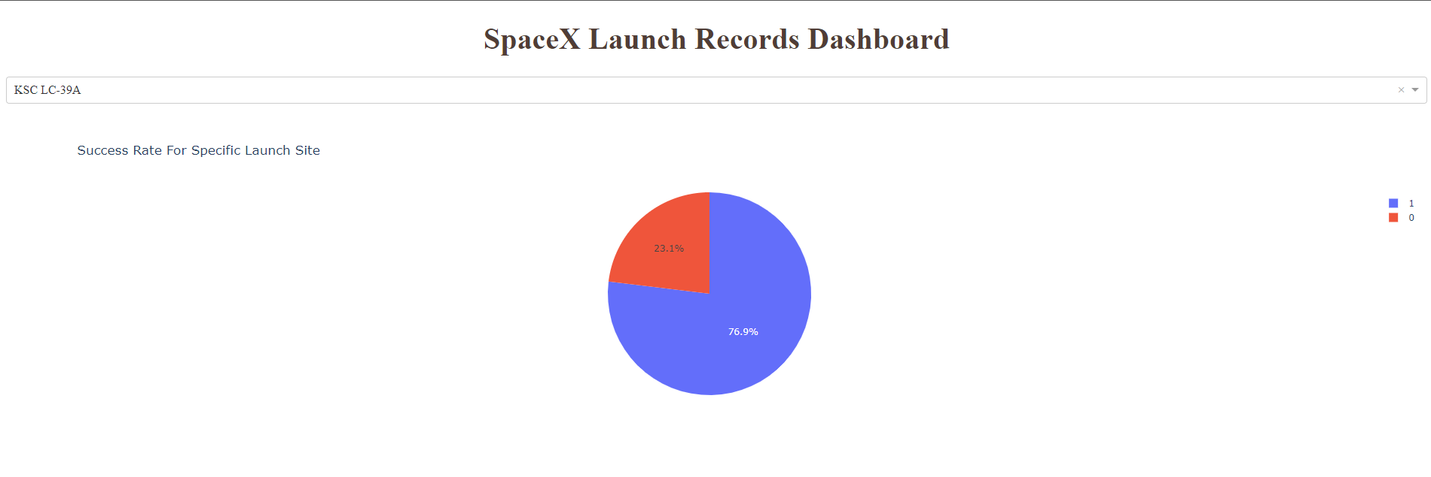
Pie Chart: Most Successful Launch Site
The most successful launch site, KSC LC-39A has a success rate of 76.9% and a failure rate of 23.1%.

Slide 41
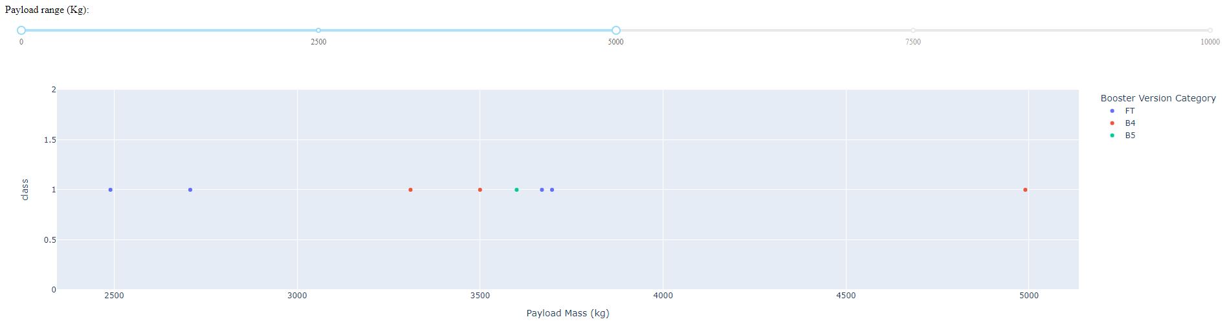
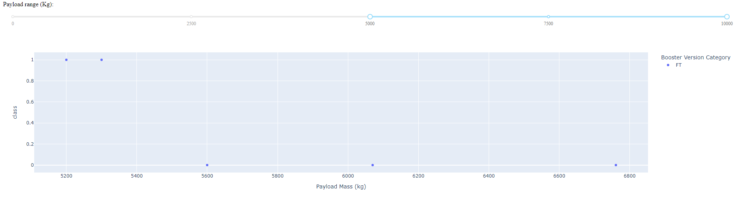
Scatter Plot: Success By Payload Mass
From the interactive scatter plots presented we observe:
FT boosters are the only booster type used for payloads with a mass greater than 5000 kg.
It is not until payload mass reaches 5600kg that we see our first failure.
Launches across all booster types are most successful with payloads ranging from ~2400 – 3800 kg.

Slide 42

Section 5

Slide 43
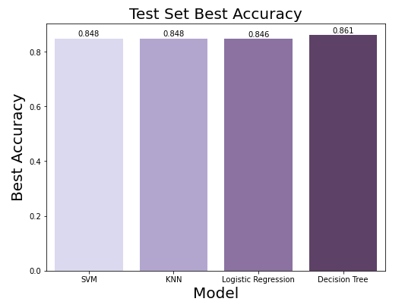
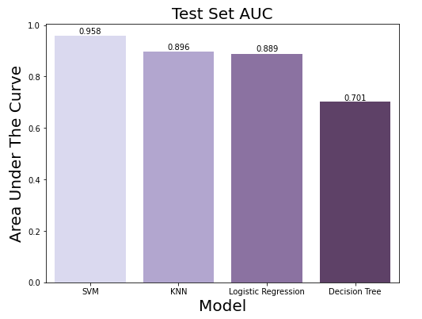
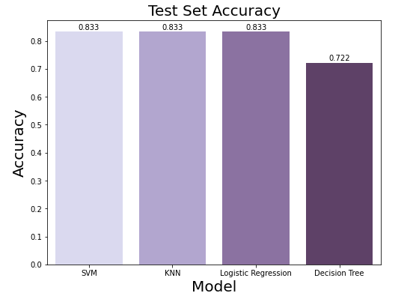
Classification Accuracy
All four models have been evaluated by three metrics:
Best Accuracy
Accuracy (actual prediction)
Area Under The Curve (AUC)
The Support Vector Machine, or SVM, performs the best as it has the highest values among all three metrics.

Slide 44
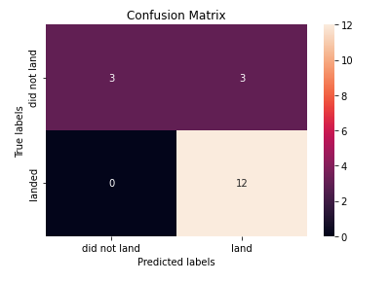
Confusion Matrix
The confusion matrix for the Support Vector Machine (SVM) classification model displays how many values were accurately predicted by the model.
In essence, the SVM correctly predicted fifteen out of eighteen outcomes.

Slide 45
Conclusions
Launch sites have a strong preference to keep away from cities, and near water sources.
The most successful launch site is KSC LC-39A at a success rate of 76.9% and a failure rate of 23.1%.
Launches dedicated to the orbits ES-L1, GEO, HEO, and SSO have the highest success rate.
The more launches, and the more time that passes, the higher the success rate.
Launch success rates increased from 2013 onwards, but not from 2010 – 2013.
The greater the payload mass the less likely it is that the first stage will return successfully.
Launches across all booster types are most successful with payloads ranging from ~2400 – 3800 kg.
FT boosters are the only booster type used for payloads with a mass greater than 5000 kg
The Support Vector Machine, or SVM, classification model is the best model for predicting landing outcomes.

Slide 46


